Slide 1



Making better conservation decisions
Jeffrey Hanson
jeffrey.hanson@uqconnect.edu.au
jeffrey-hanson.com

Slide 2






Acknowledgements
Adam Marques
Ana Veríssimo
Caitlyn Proctor
Carlo Rondinini
Cynthia Riginos
Emma Hudgins
Francesco Ficetola
Graeme Buchanan
Guillermo Velo-Antón
Hugh Possingham
Iadine Chadès
Íñigo Martínez-Solano
Jenny McCune
Jonathan Rhodes
Joseph Bennett
Matt Watts
Matthew Strimas-Mackey
Miguel Camacho-Sanchez
Nina Morell
Peter Arcese
Richard Fuller
Richard Schuster
Silvia Carvalho
Stuart Butchart

Slide 3
Now
Biodiversity
Status quo
2000
Future

Slide 4
Now
How do we
get here?
Biodiversity
Status quo
2000
Future

Slide 5



Ecological surveys
Distribution maps
Priority areas
Biodiversity
2000
Future
Data
Information
Plan
Outcome
Objectives
Constraints

Slide 6
How can we get a better conservation decision?
(1) Better algorithms
(2) Better data
(3) Better surrogates

Slide 7
Ecological surveys
Distribution maps
Priority areas
Biodiversity
2000
Future
Data
Information
Plan
Outcome
Objectives
Constraints

Slide 8
Ecological surveys
Distribution maps
Priority areas
Biodiversity
2000
Future
Data
Information
Plan
Outcome
Better
algorithms
Better
outcome
Objectives
Constraints

Slide 9
Reserve selection
Features
Notes:
- not all remaining habitat can be preserved
- achieve conservation objectives for minimal cost
- modern systematic conservation planning primarily focusses on representing species
- however, this ignores intra-specific biodiversity

Slide 10
Reserve selection
Planning units

Slide 11
Reserve selection
?
?
?
?
?
?

Slide 12
Reserve selection

Slide 13





Heuristic
algorithm
Meta-heuristic
algorithms
Exact
algorithms
Estimate of best quality
Quality
Different
solutions
Different
solutions
Different
solutions

Slide 14

prioritizr R package
What you value
Input to solver
Data
Mathematical
optimization
problem
Biodiversity
Land use
Economic
Solve problem
What the solution
must (or mustn't) do
Maps
Statistics
Hanson et al. 2020 CRAN

Slide 15
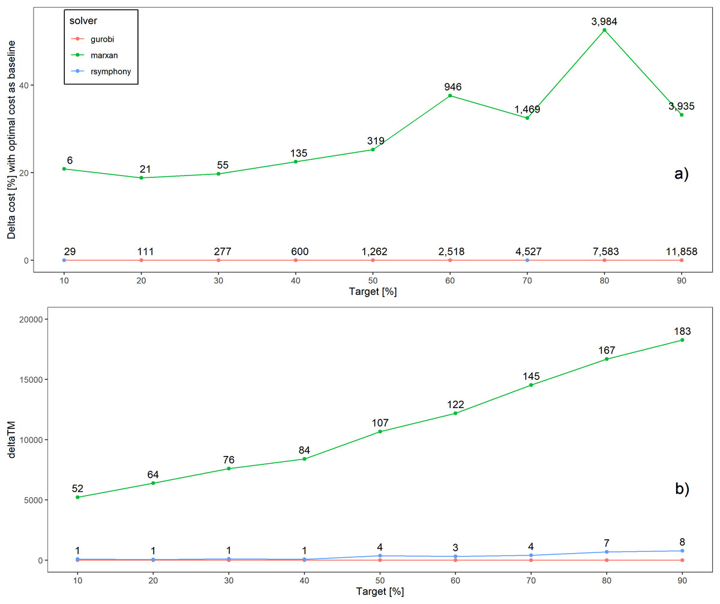
Better solutions
Schuster et al. 2020 PeerJ

Slide 16
…and faster too!
Time difference
Schuster et al. 2020 PeerJ

Slide 17
What about other conservation problems?

Slide 18



Project prioritization
Feature data
Phylogenetic data
Stakeholder weights
Project data
Recovery projects

Slide 19




Project prioritization
Feature data
Phylogenetic data
Stakeholder weights
Project data
Cost data
Actions
Persistence (%)
$
$$
$$$$$
Recovery projects

Slide 20
Project prioritization
Feature data
Phylogenetic data
Stakeholder weights
Project data
Cost data
Actions
$
Success
90%
$$
20%
$$$$$
Recovery projects
50%

Slide 21
Project prioritization
Feature data
Phylogenetic data
Stakeholder weights
Project data
Cost data
Actions
Persistence (%)
$
Success
90%
95%
$$
20%
10%
$$$$$
Recovery projects
50%
70%

Slide 22
Project prioritization
Feature data
Phylogenetic data
Stakeholder weights
Project data
Cost data
Actions
Persistence (%)
$
Success
90%
95%
$$
20%
10%
$$$$$
Recovery projects
50%
70%
$0
100%
40%
9%
65%

Slide 23
Project prioritization
Feature data
Phylogenetic data
Stakeholder weights
Project data
Cost data
Actions
Persistence (%)
$
Success
90%
95%
$$
20%
10%
$$$$$
Recovery projects
50%
70%
$0
100%
40%
9%
65%

Slide 24
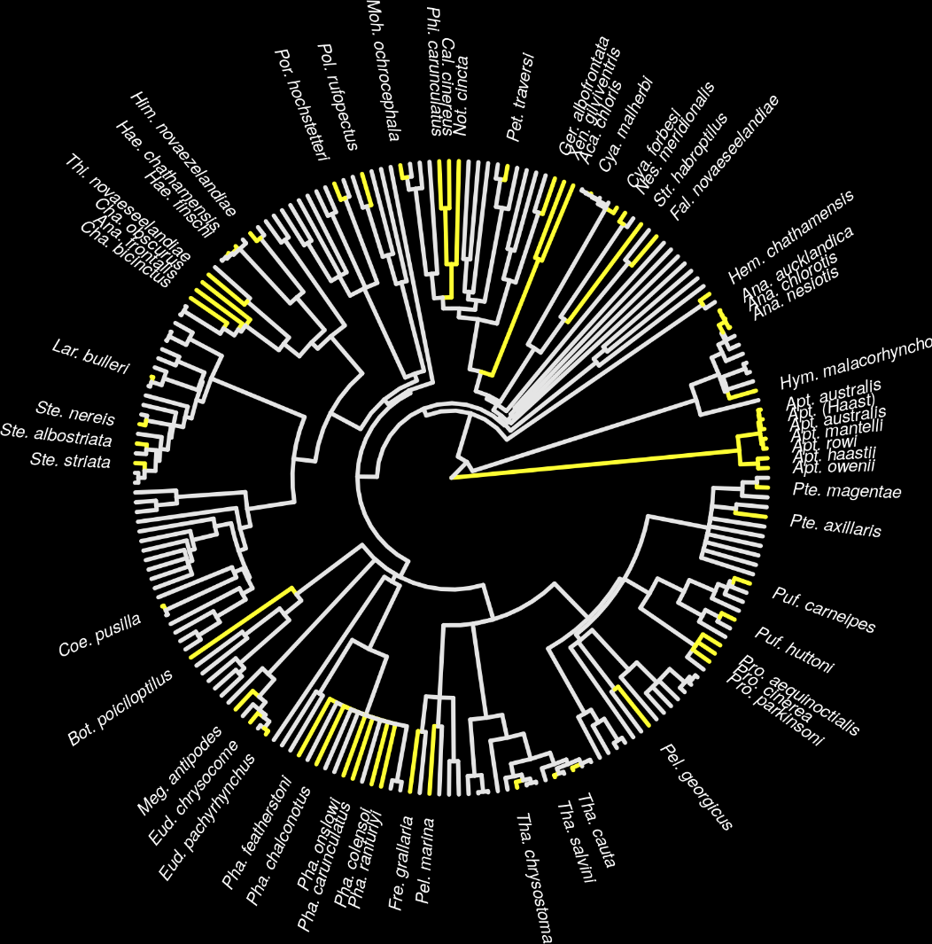
New Zealand case study
Projects for 62 imperilled bird species
1,218 different actions
Many actions shared between projects for different species
Hanson et al. 2019 Methods Ecol Evol

Slide 25
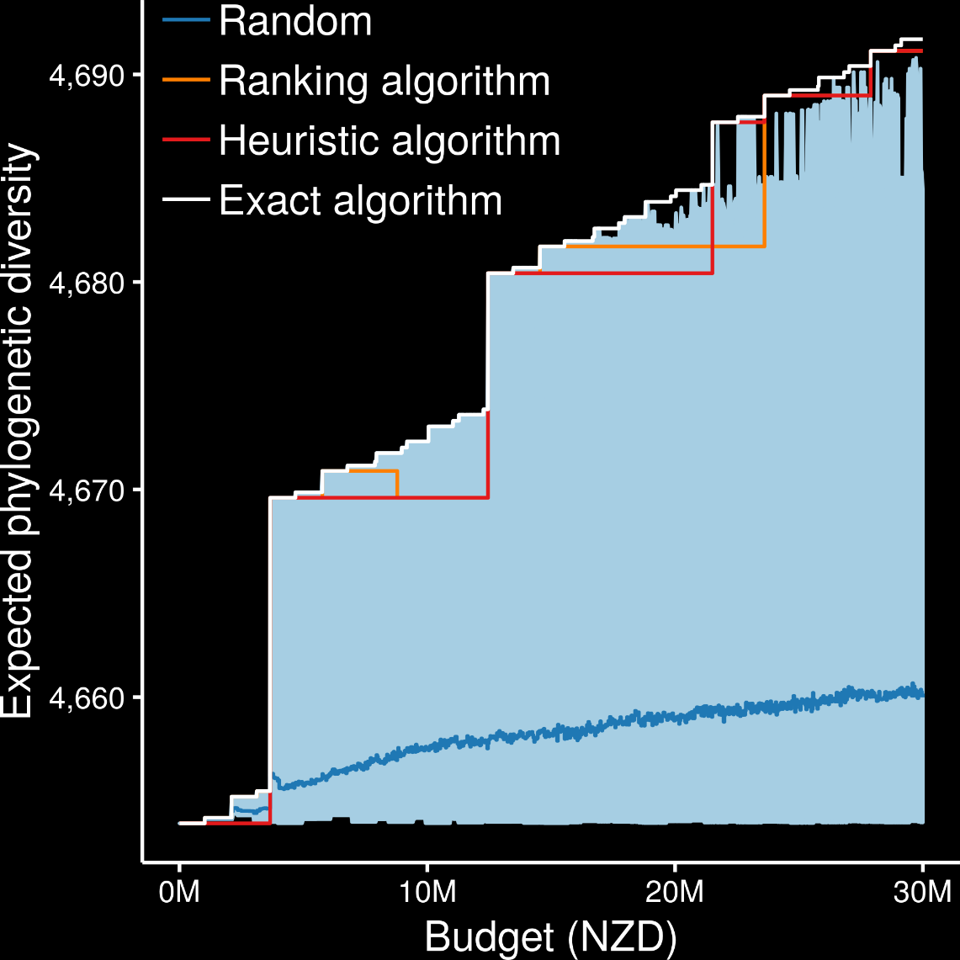
Exact algorithms always best
Ranking and heuristic algorithms sometimes produced optimal plans
Randomly funding projects sometimes produced better plans than ranking and heuristic algorithms
Hanson et al. 2019 Methods Ecol Evol

Slide 26
How can we get a better conservation decision?
(1) Better algorithms
(2) Better data
(3) Better surrogates

Slide 27
Ecological surveys
Distribution maps
Priority areas
Biodiversity
2000
Future
Data
Information
Plan
Outcome
Objectives
Constraints

Slide 28
Ecological surveys
Distribution maps
Priority areas
Biodiversity
2000
Future
Data
Information
Plan
Outcome
Better
understanding
of biodiversity
Better
plan
Better
outcome
Genetic samples
Objectives
Constraints

Slide 29
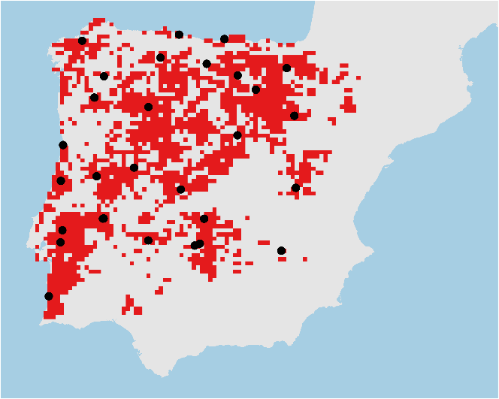
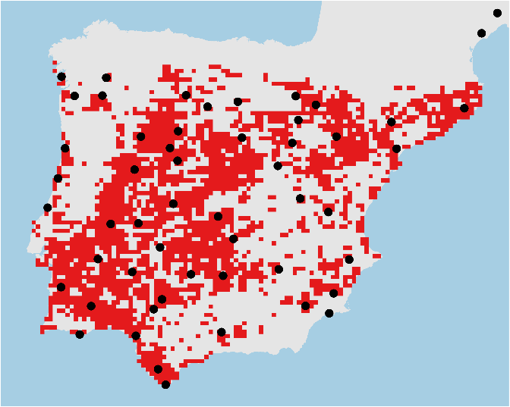
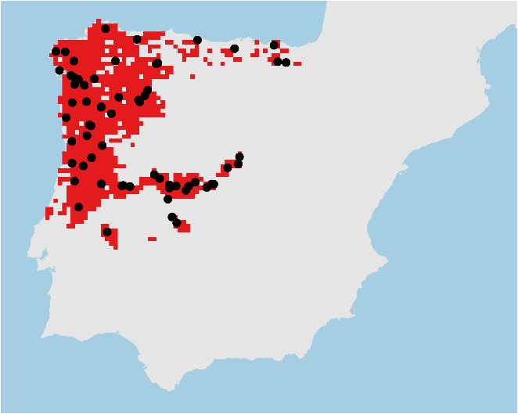

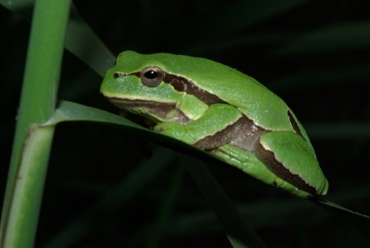
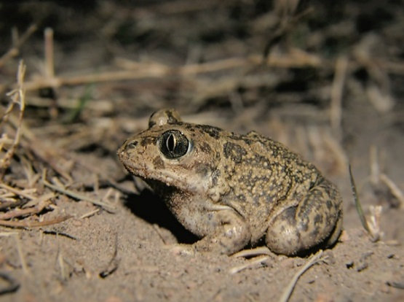
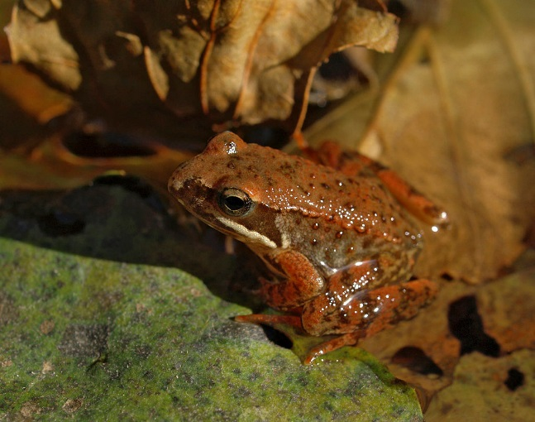
Conservation planning for adaptive and neutral evolutionary processes
Hyla molleri
Pelobates cultripes
Rana iberica

Slide 30
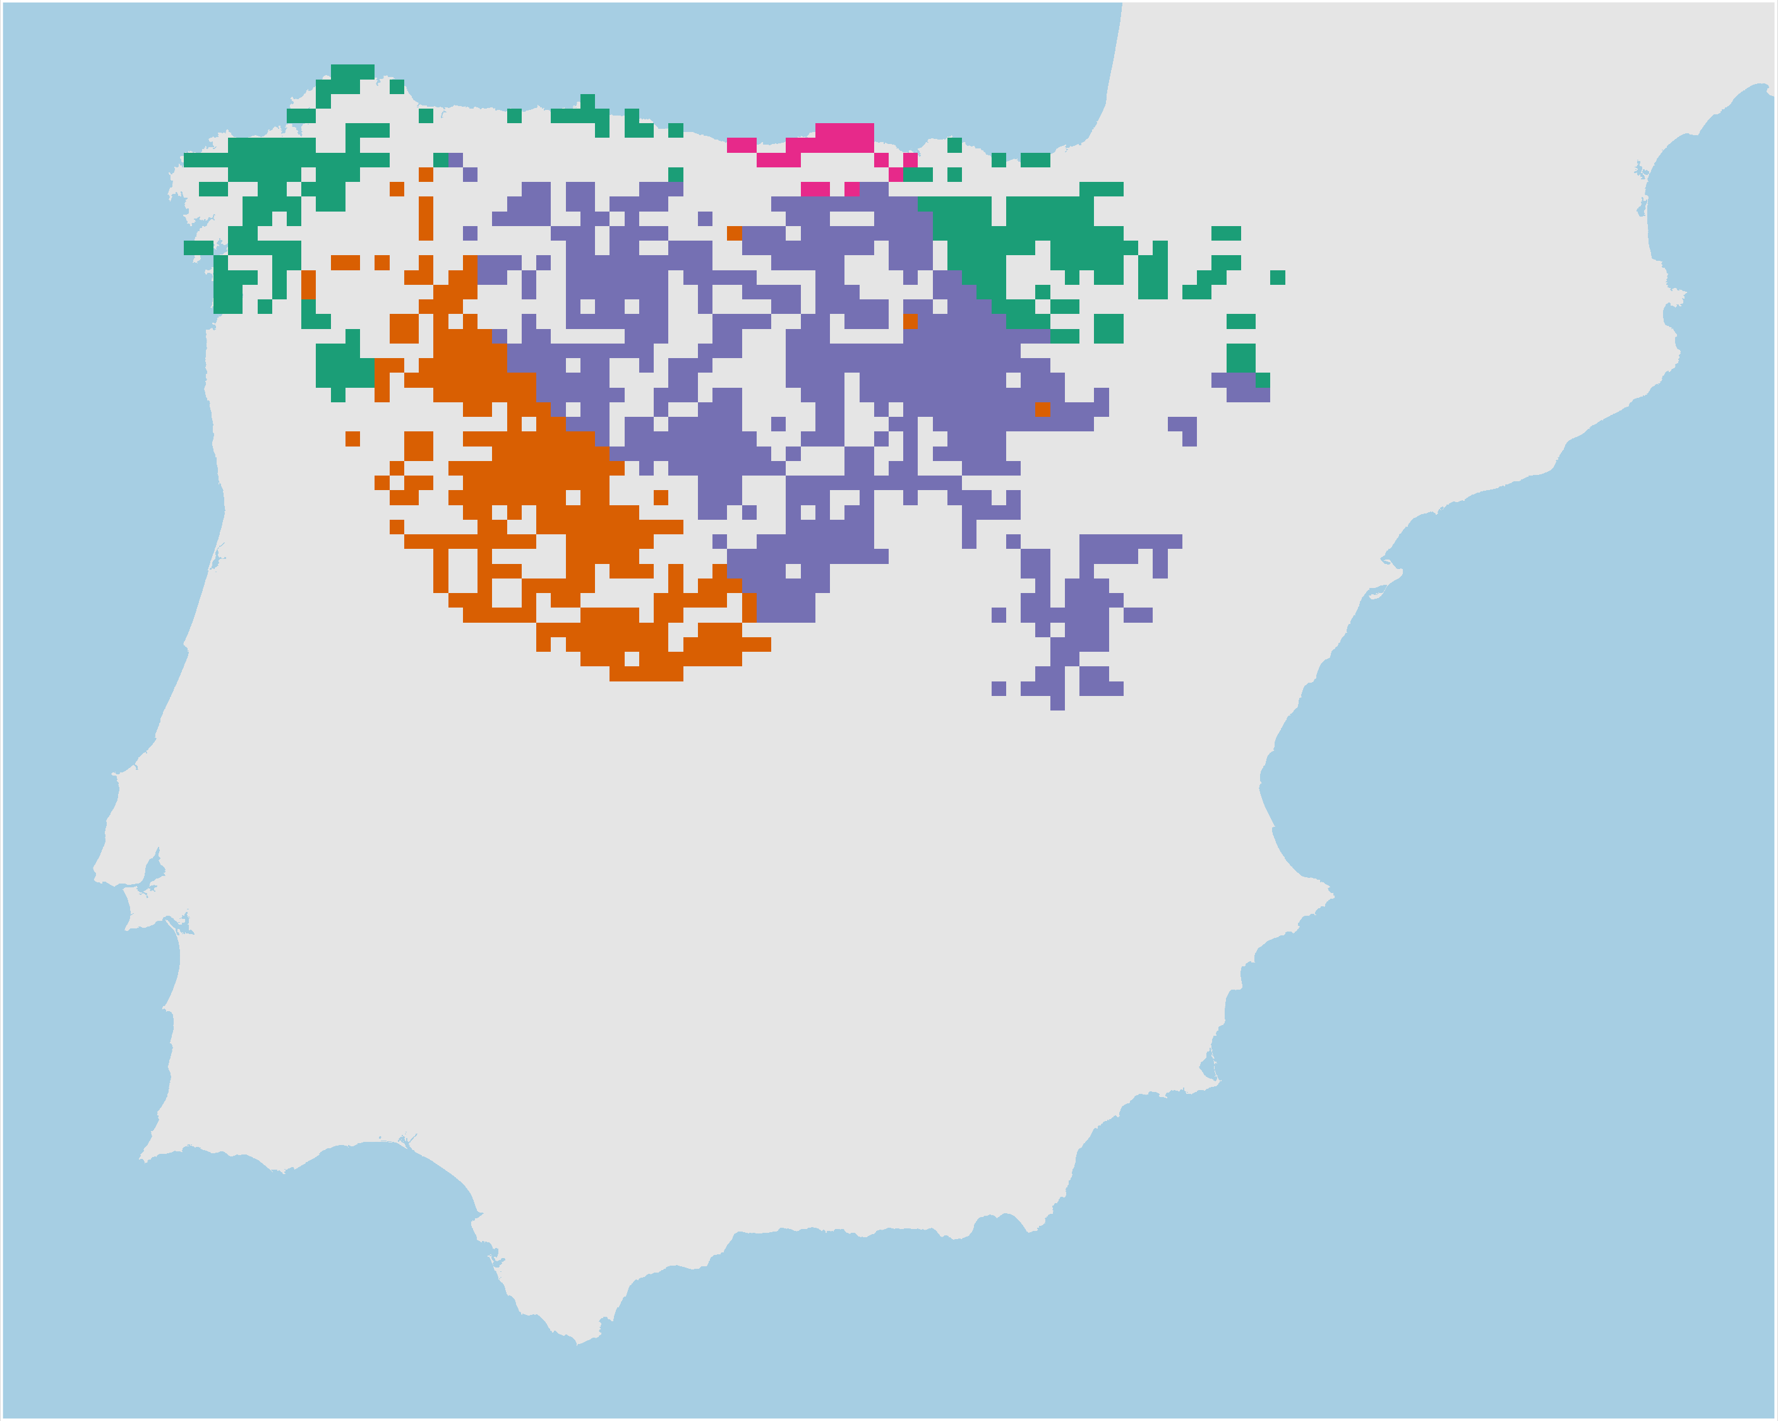
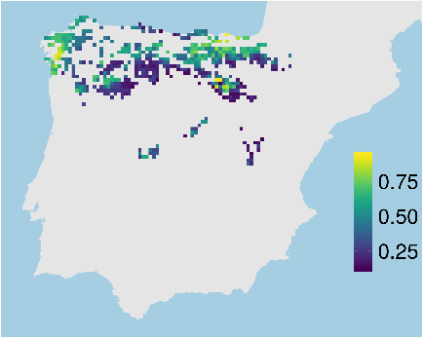
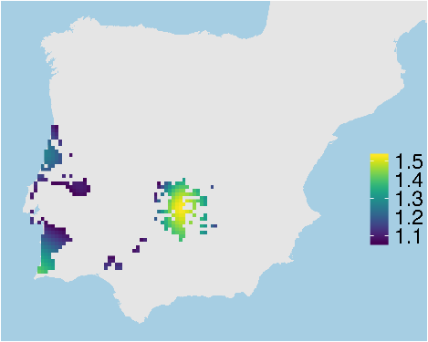
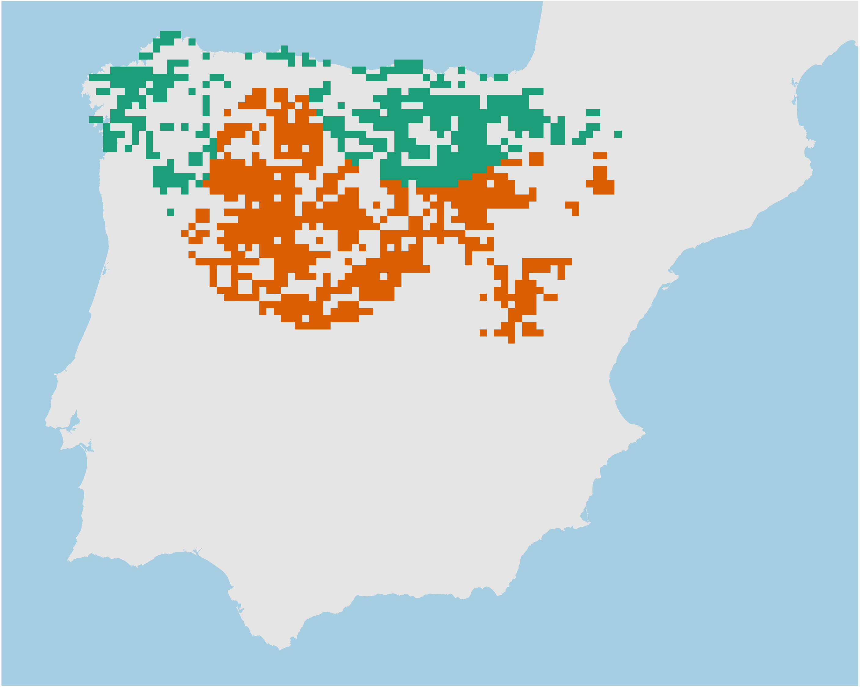
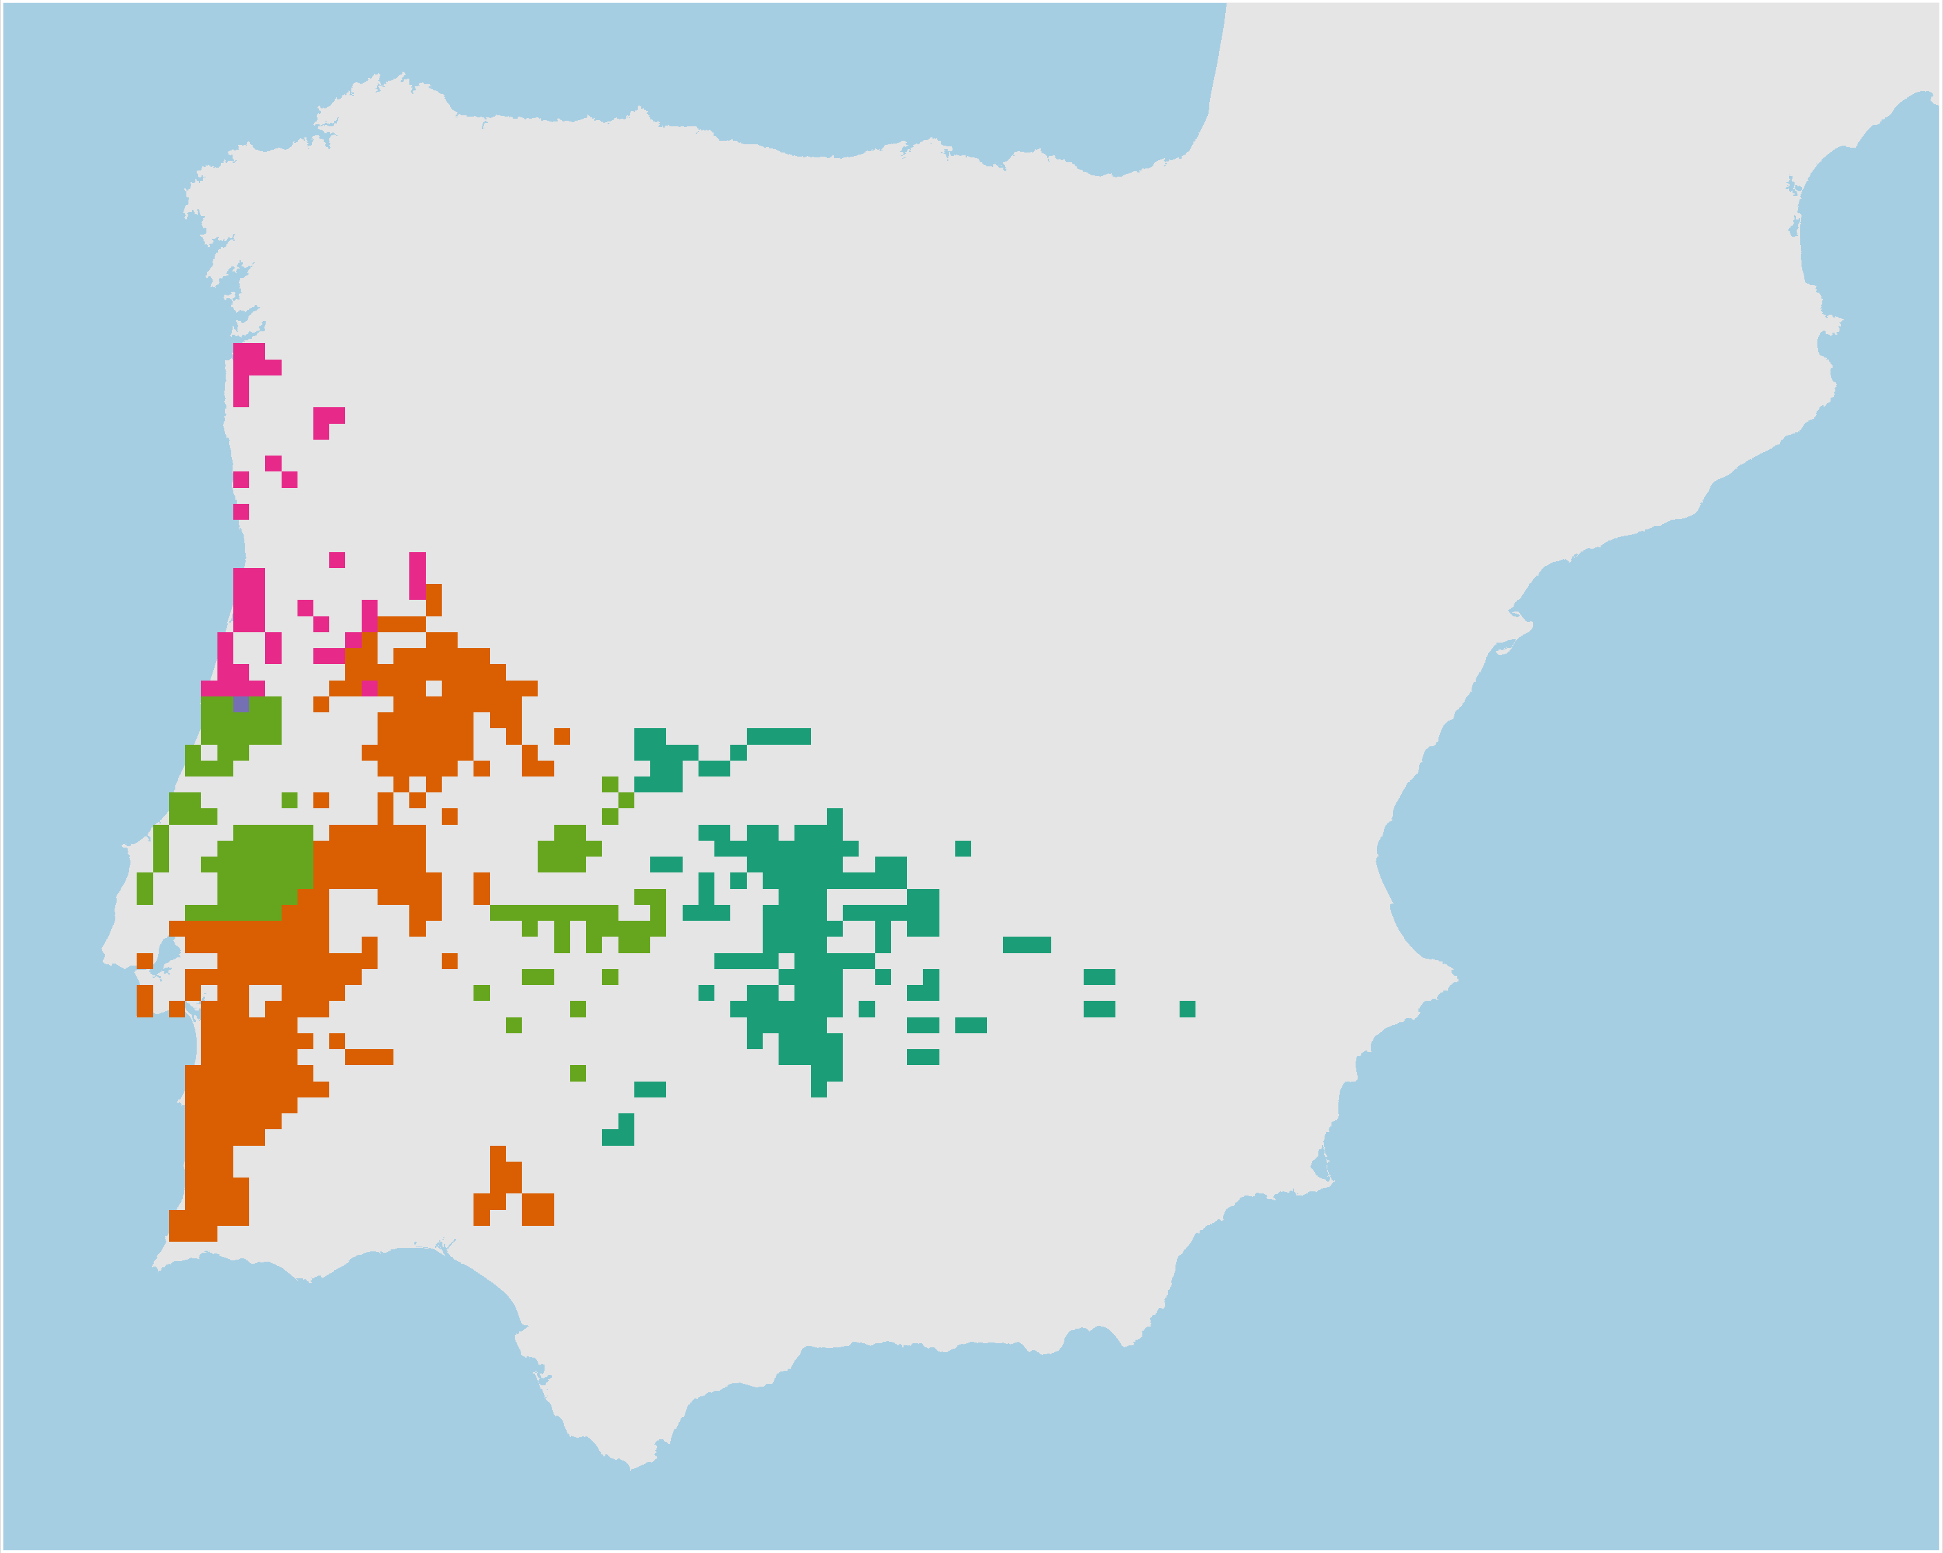
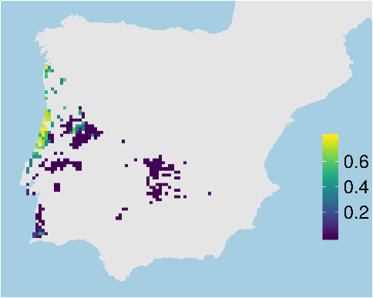
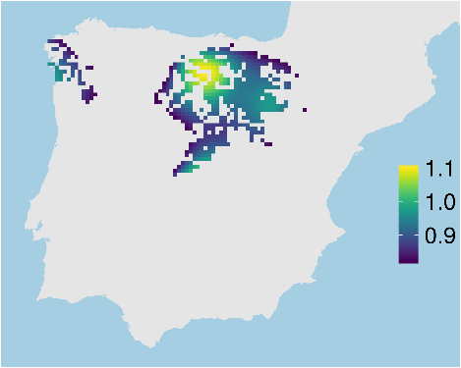
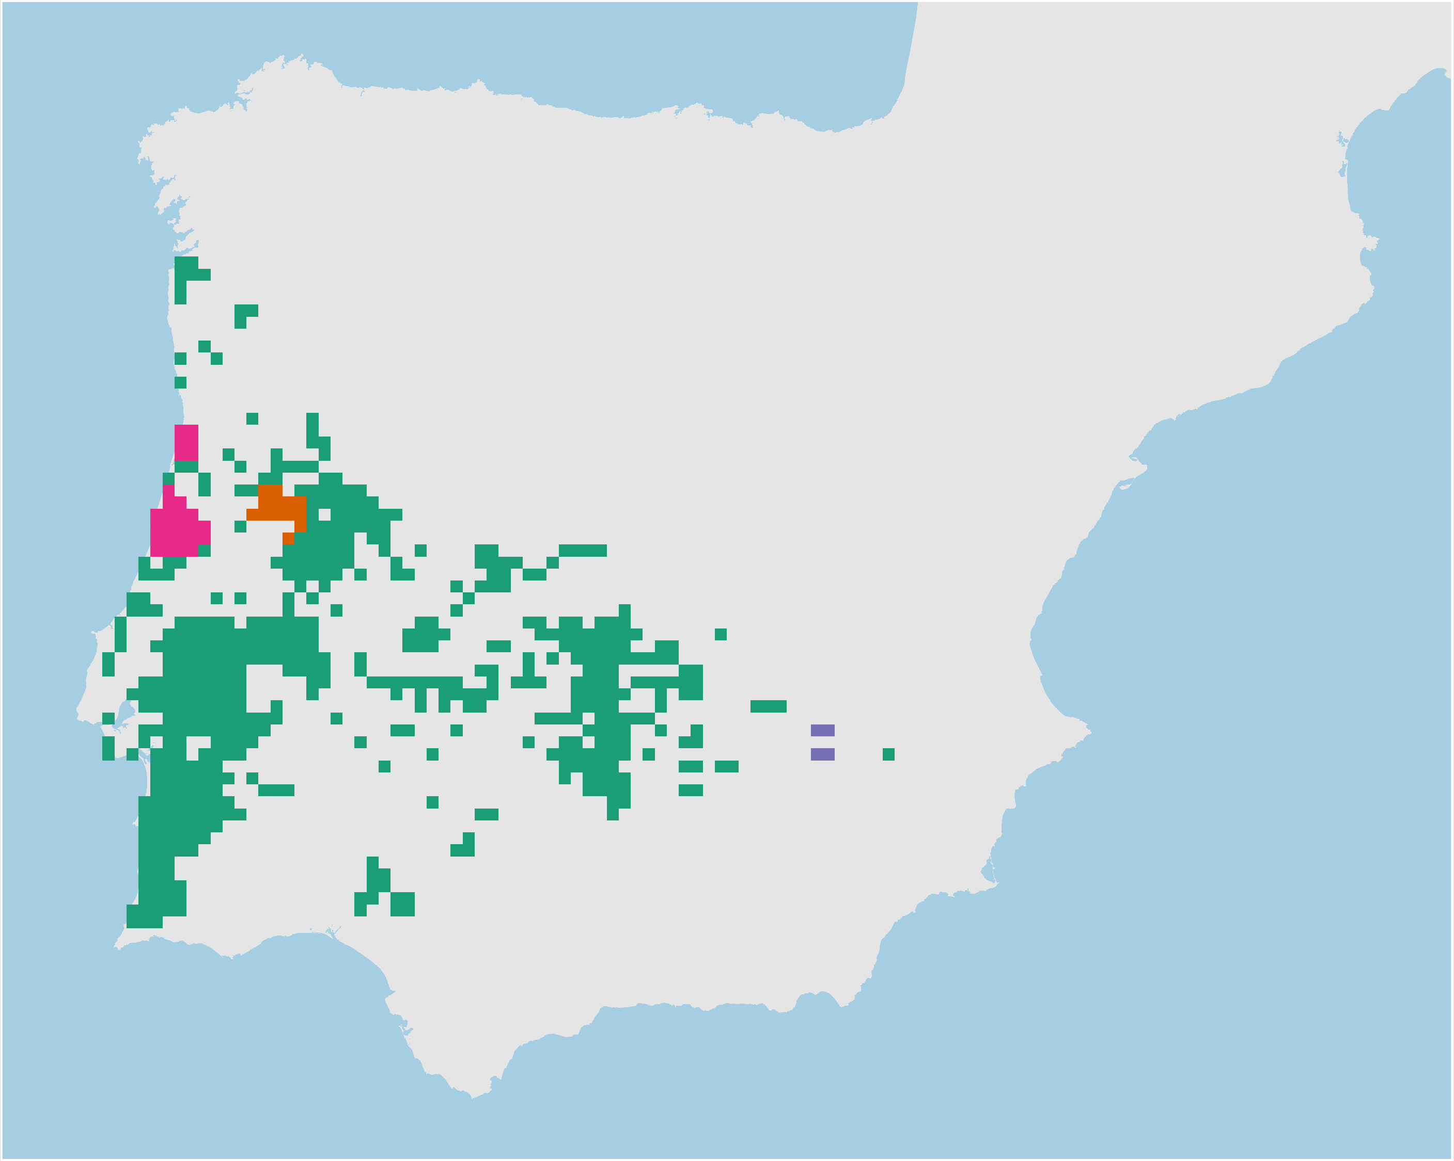
Adaptive processes
Neutral processes
Hyla
molleri
Adaptive
clusters
Climate
refugia
Individual
heterozygosity
Neutral
clusters

Slide 31
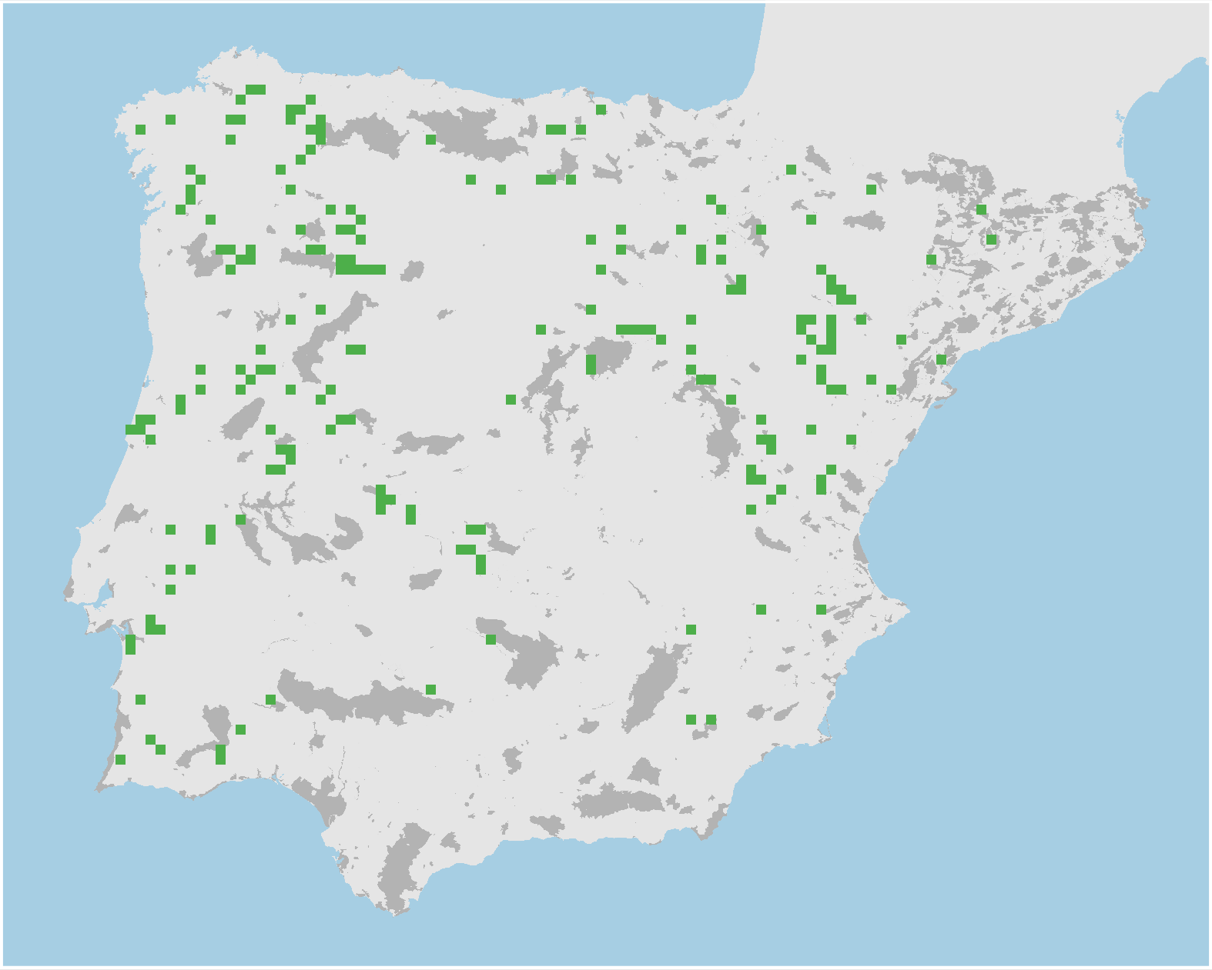
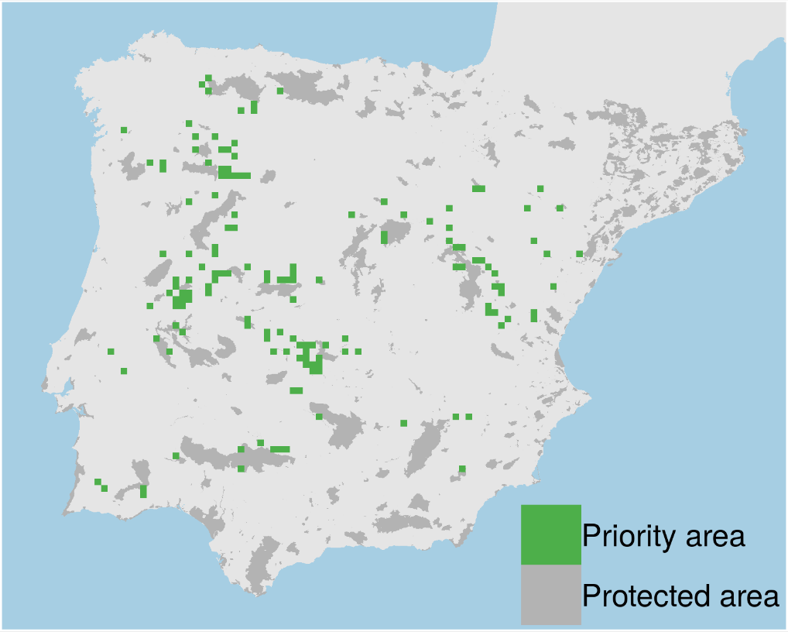
Prioritizations
Plan with evolutionary
attributes
Conventional plan
Only costs 9% less

Slide 32
However, more data isn’t always better…

Slide 33
Ecological surveys
Distribution maps
Priority areas
Biodiversity
2000
Future
Data
Information
Plan
Outcome
Objectives
Constraints

Slide 34
Ecological surveys
Distribution maps
Priority areas
Biodiversity
?
?
?
?
?
?
2000
Future
Data
Information
Plan
Outcome
More
surveys
Better
models
Better
management
Better
outcome
Objectives
Constraints

Slide 35
Ecological surveys
Distribution maps
Prioritization
Biodiversity
?
?
?
?
?
?
?
?
?
?
?
?
2000
Future
Data
Information
Plan
Outcome
More
surveys
Better
models
Poorer
management
Worse
outcome
Objectives
Constraints
Less funding

Slide 36
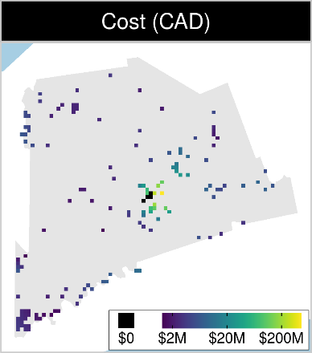
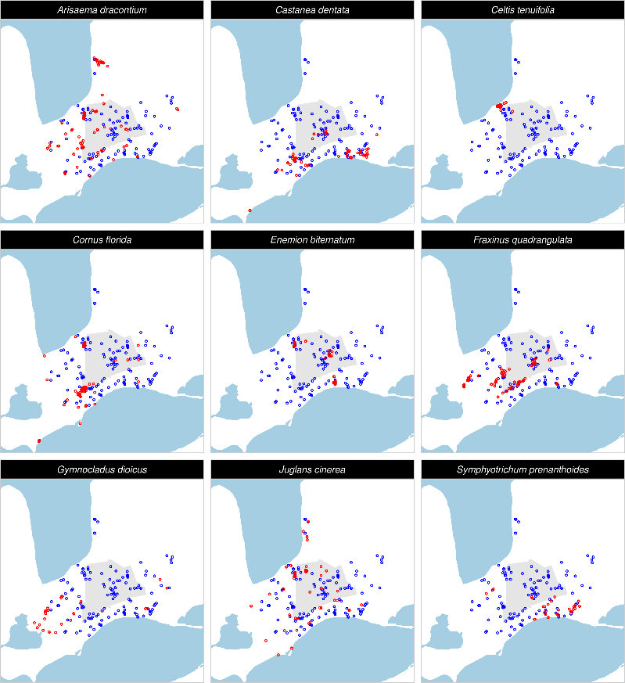
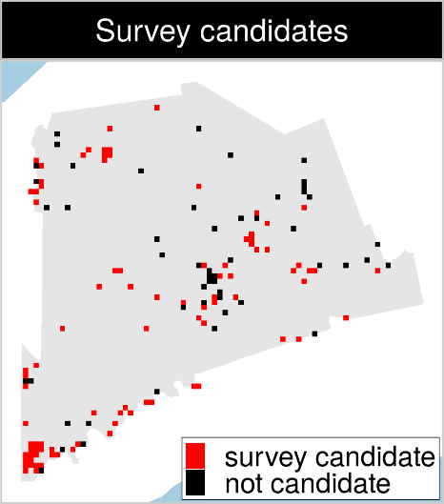
Optimizing ecological surveys for conservation
142 places that could
potentially be acquired for
protected area establishment
90 places that could potentially be surveyed to
improve existing data
9 imperilled plant species

Slide 37
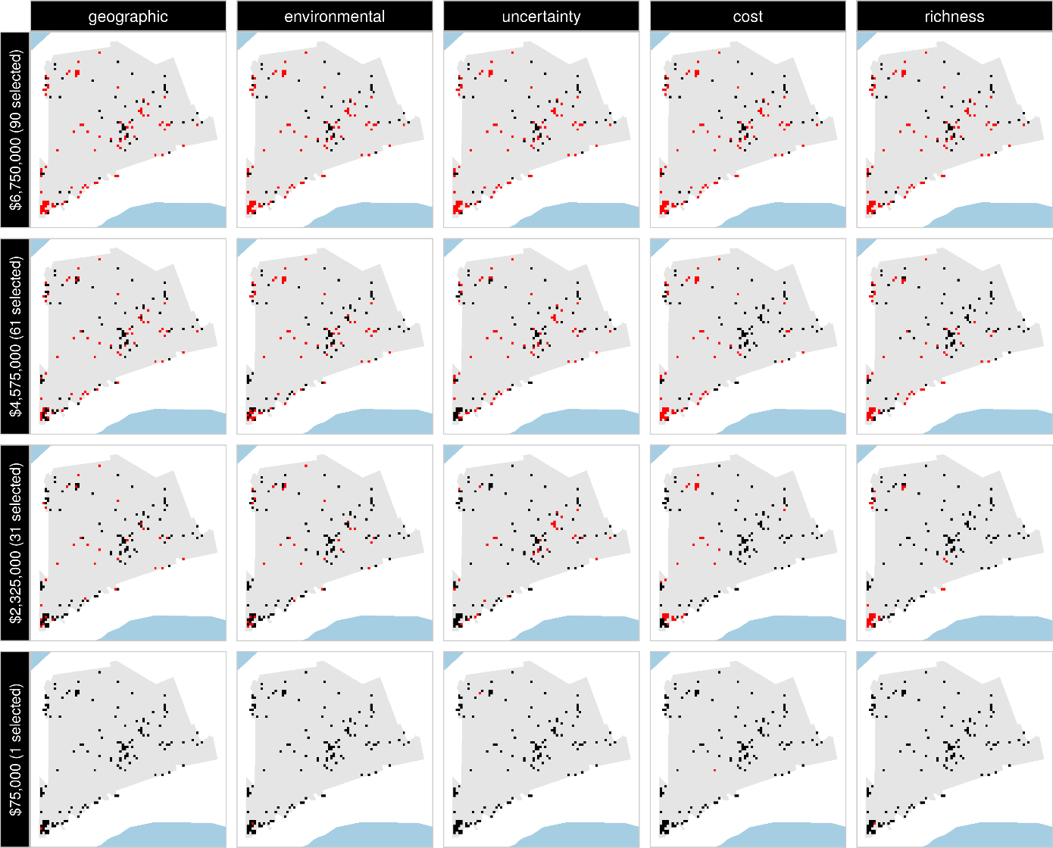
Selected
for survey
Number of places selected for surveys
(amount of funds allocated for collecting extra data)
NOT selected
for survey
Different approaches for designing survey schemes

Slide 38
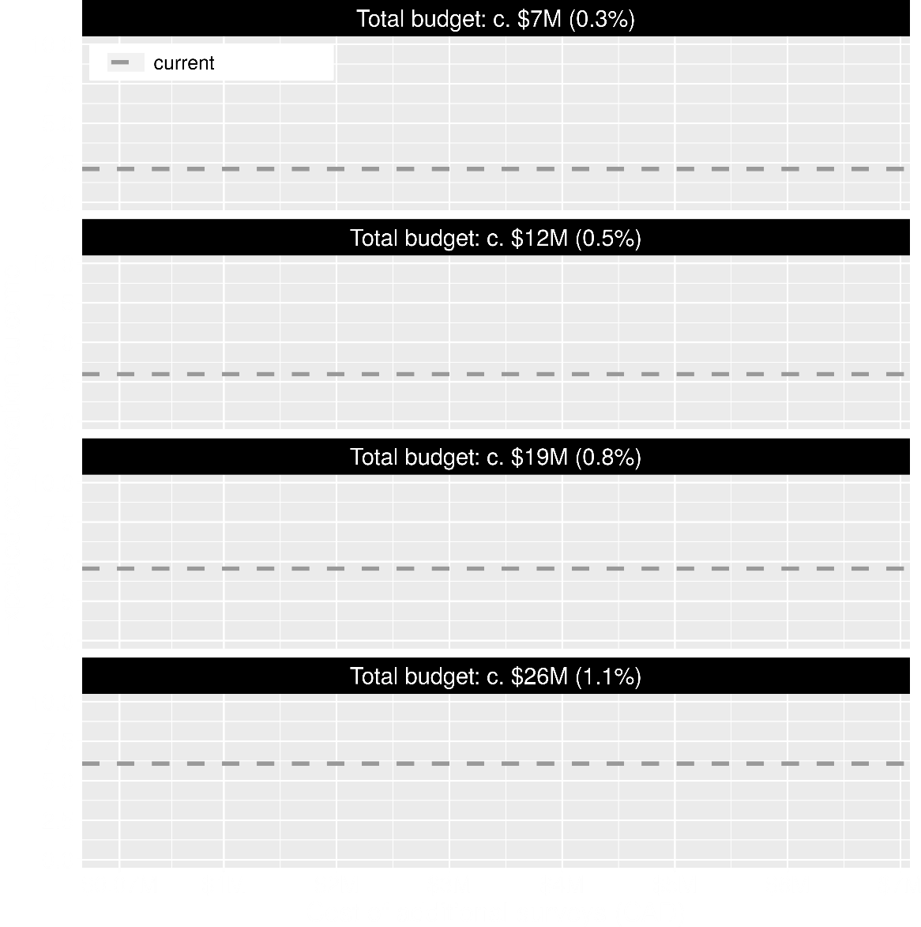
Value of information
Existing data leads to positive outcomes
More budget means better outcomes

Slide 39
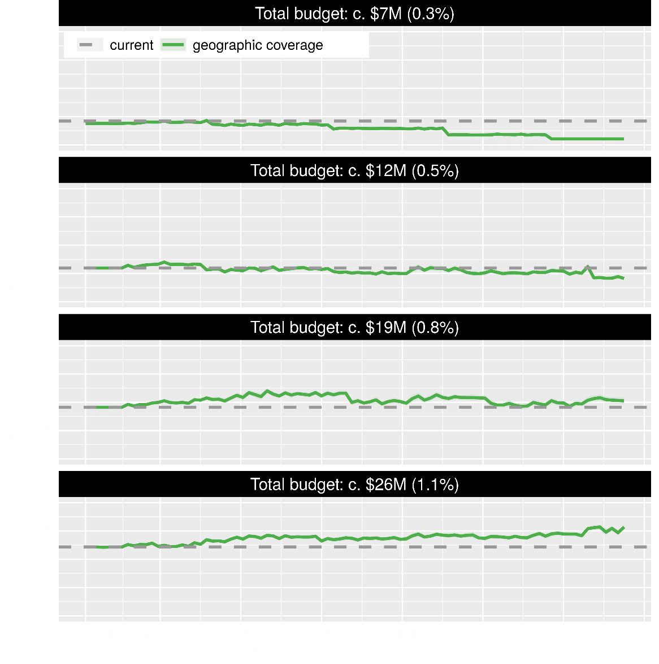
Value of information
Allocating funds for gathering more data can mean worse outcomes
Allocating funds for gathering more data can mean better outcomes too

Slide 40
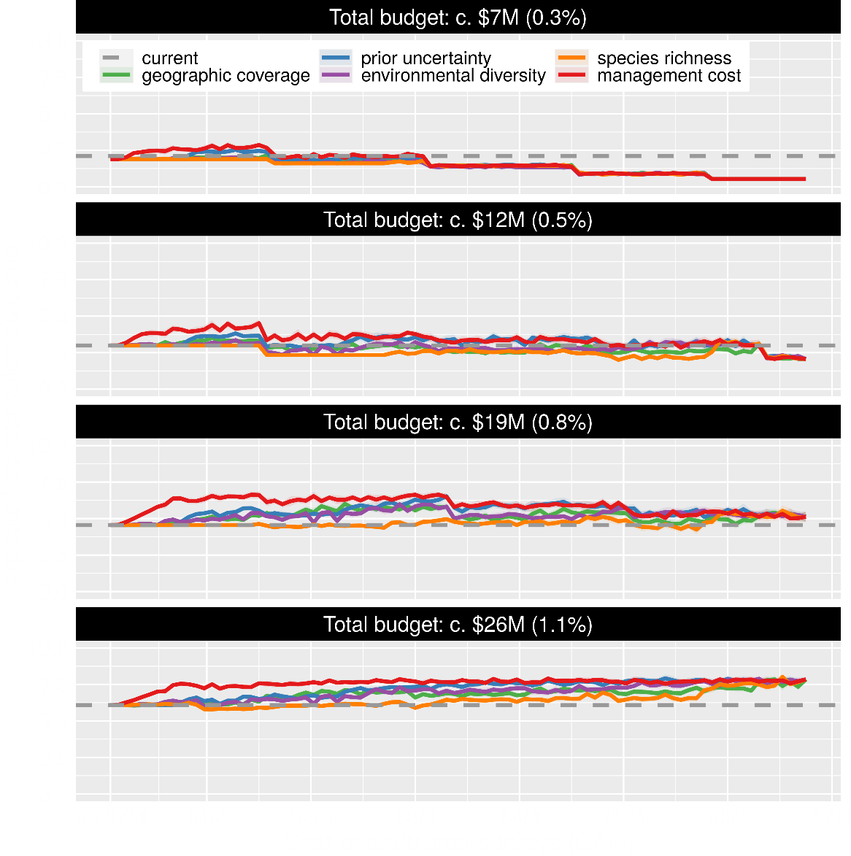
Value of information
Conventional approaches for gathering additional evidence have different performance
Performance of these approaches depends on available funds
All of them could lead to lead to worse outcomes

Slide 41
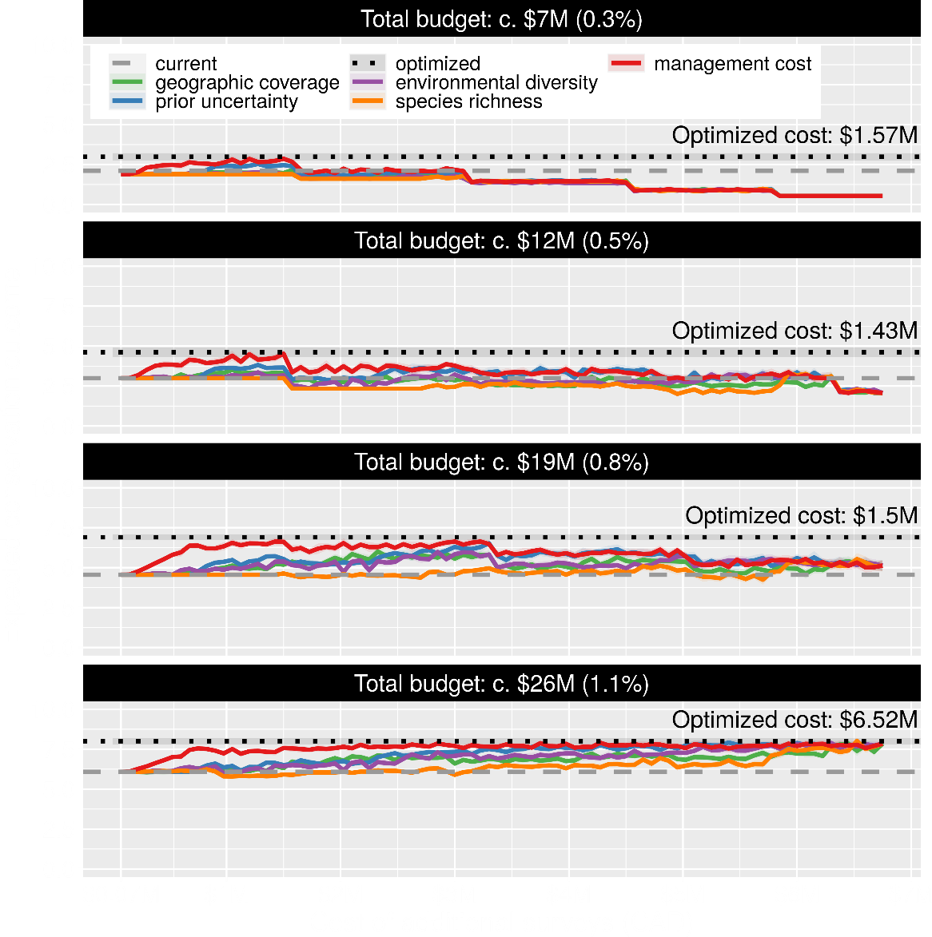
Value of information
Directly maximizing return on investment is best method for additional data
This considers objectives and constraints that underpin conservation plans and their success

Slide 42
How can we get a better conservation decision?
(1) Better algorithms
(2) Better data
(3) Better surrogates

Slide 43
Evolutionary processes
Species range
Population

Slide 44
Evolutionary processes
Species range
Population

Slide 45
Evolutionary processes
Species range
Population

Slide 46
Evolutionary processes
Species range
Population

Slide 47
Ecological surveys
Distribution maps
Priority areas
Biodiversity
2000
2100
Data
Information
Plan
Outcome
Really good
understanding
of biodiversity
Better
plan
Better
outcome
Genetic samples
Objectives
Constraints

Slide 48
Ecological surveys
Distribution maps
Priority areas
Biodiversity
2000
2100
Data
Information
Plan
Outcome
Good enough
understanding
of biodiversity
Better
plan
Better
outcome
Environment data
Cold
Objectives
Constraints
Hot

Slide 49
Can we use environmental and geographic variables as surrogates of genetic variation for conservation planning?

Slide 50
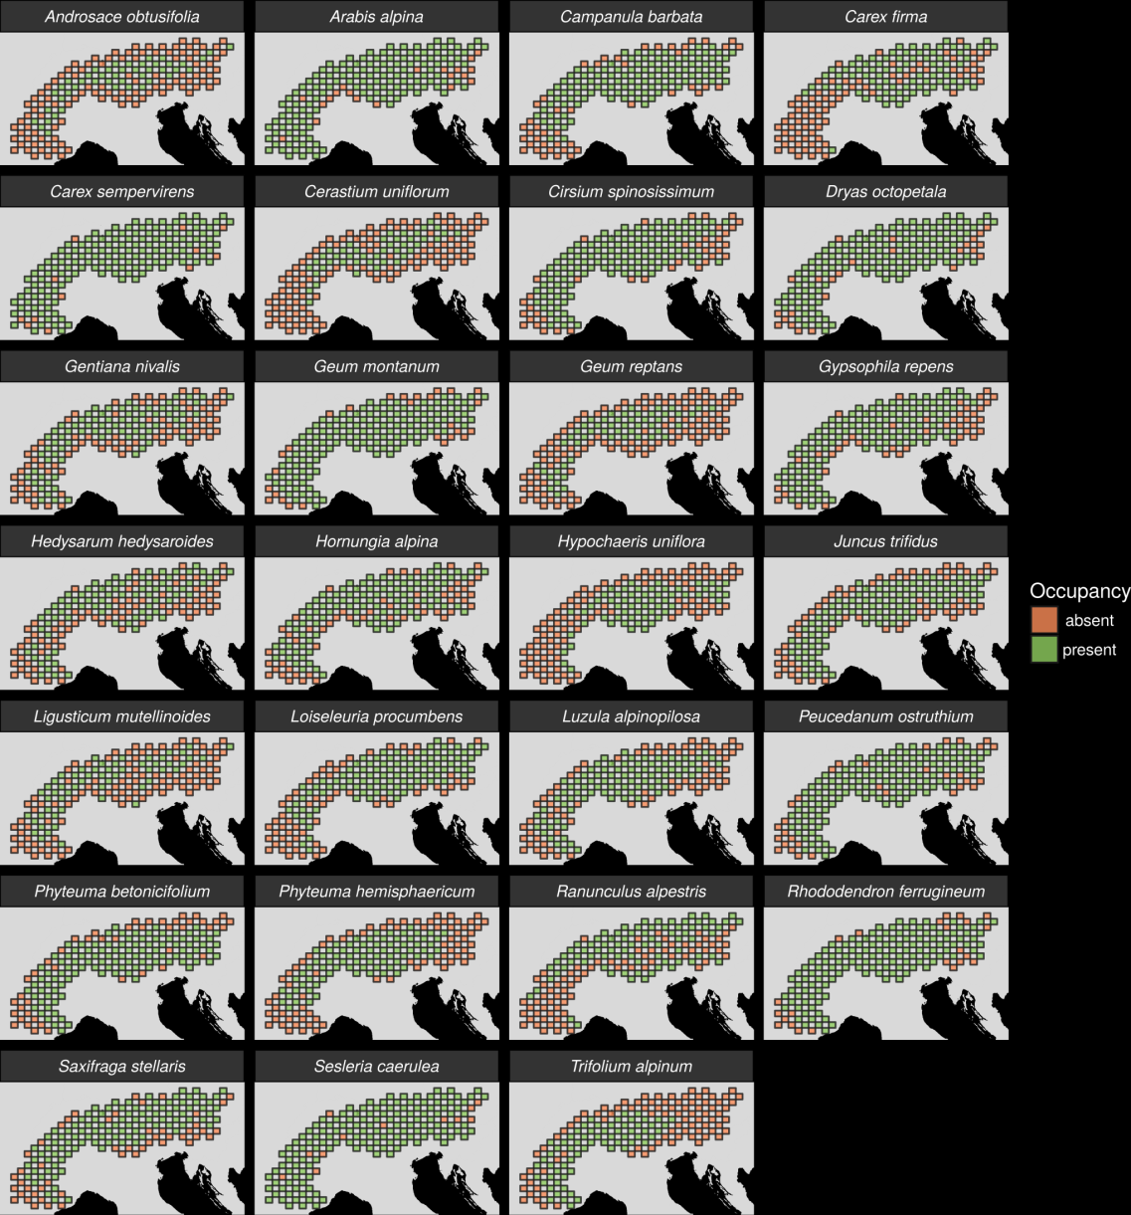
27 plant species
Different dispersal
Different life-histories
Different niches
Alpine environment =
EASY MODE
AFLP markers
Hanson et al. 2017 PNAS

Slide 51
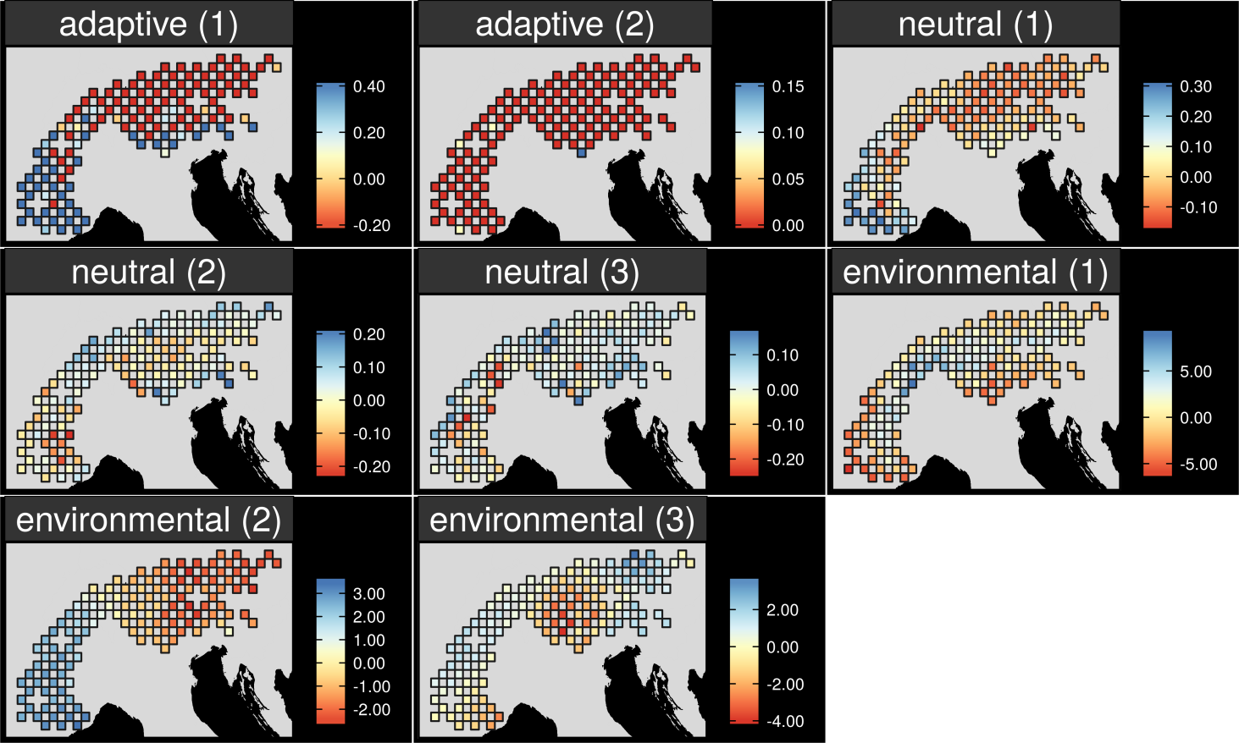
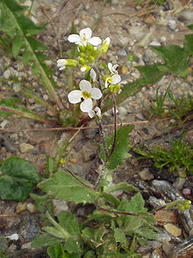
Map intra-specific variation
Arabis alpina
Hanson et al. 2017 PNAS

Slide 52
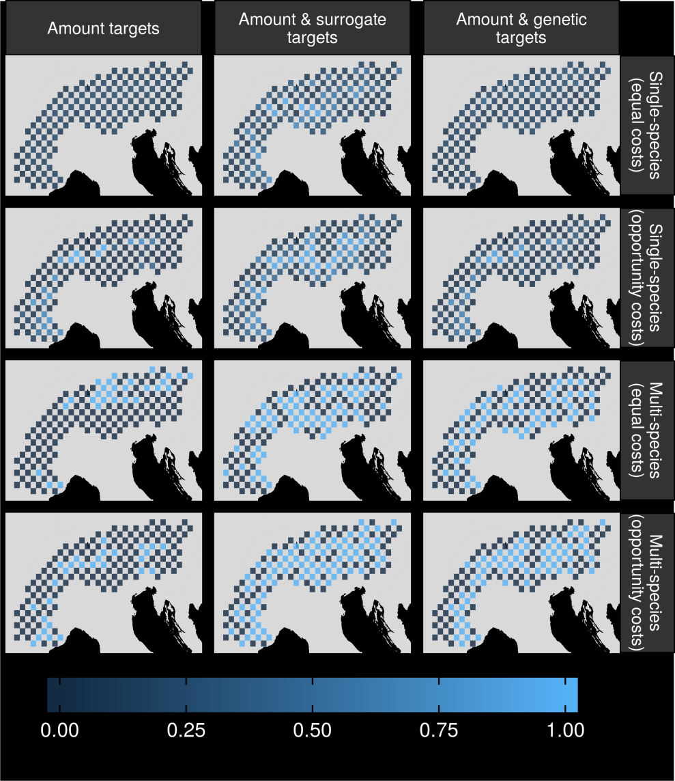
Can surrogates inform our decisions?
Hanson et al. 2017 PNAS

Slide 53
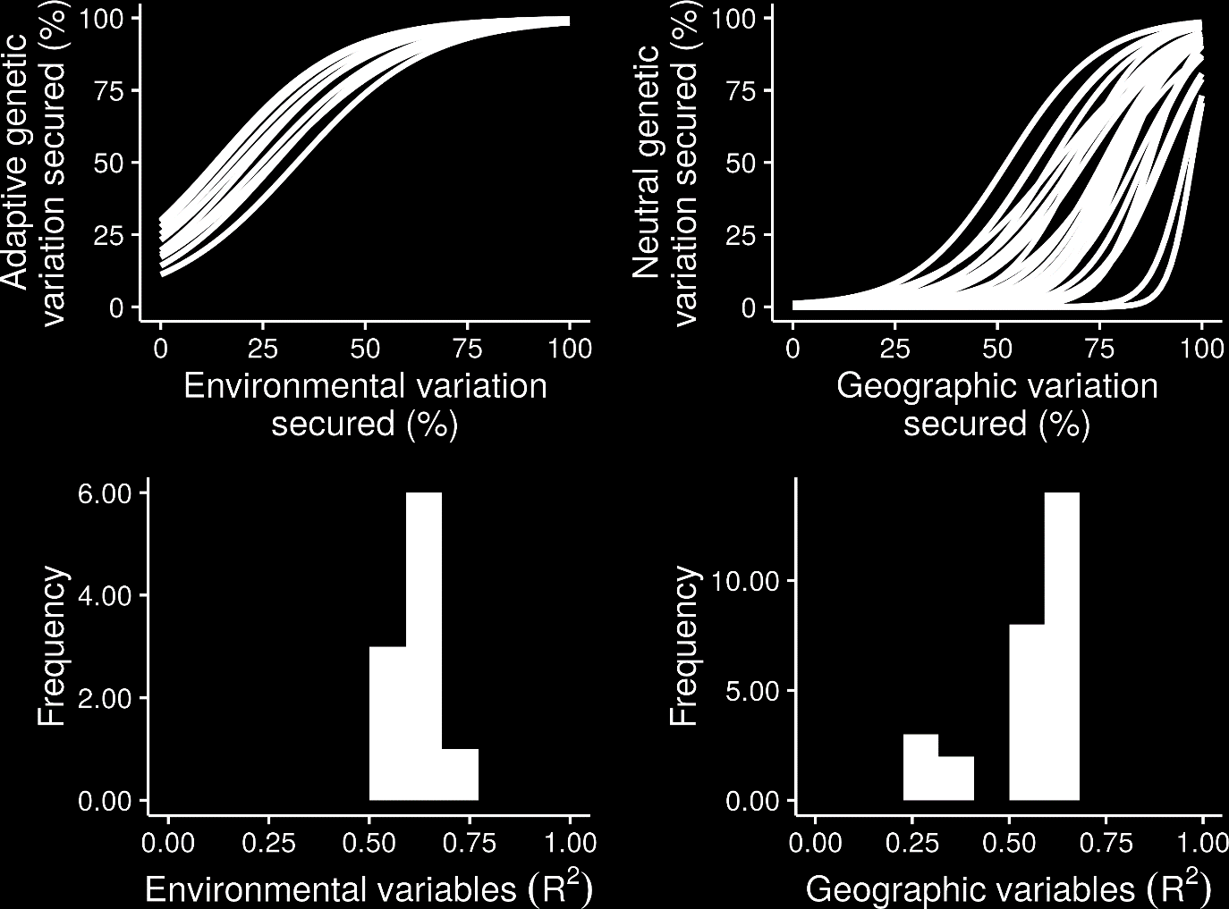
What is the relationship?
Hanson et al. 2017 PNAS

Slide 54
What is the relationship?
Hanson et al. 2017 PNAS

Slide 55
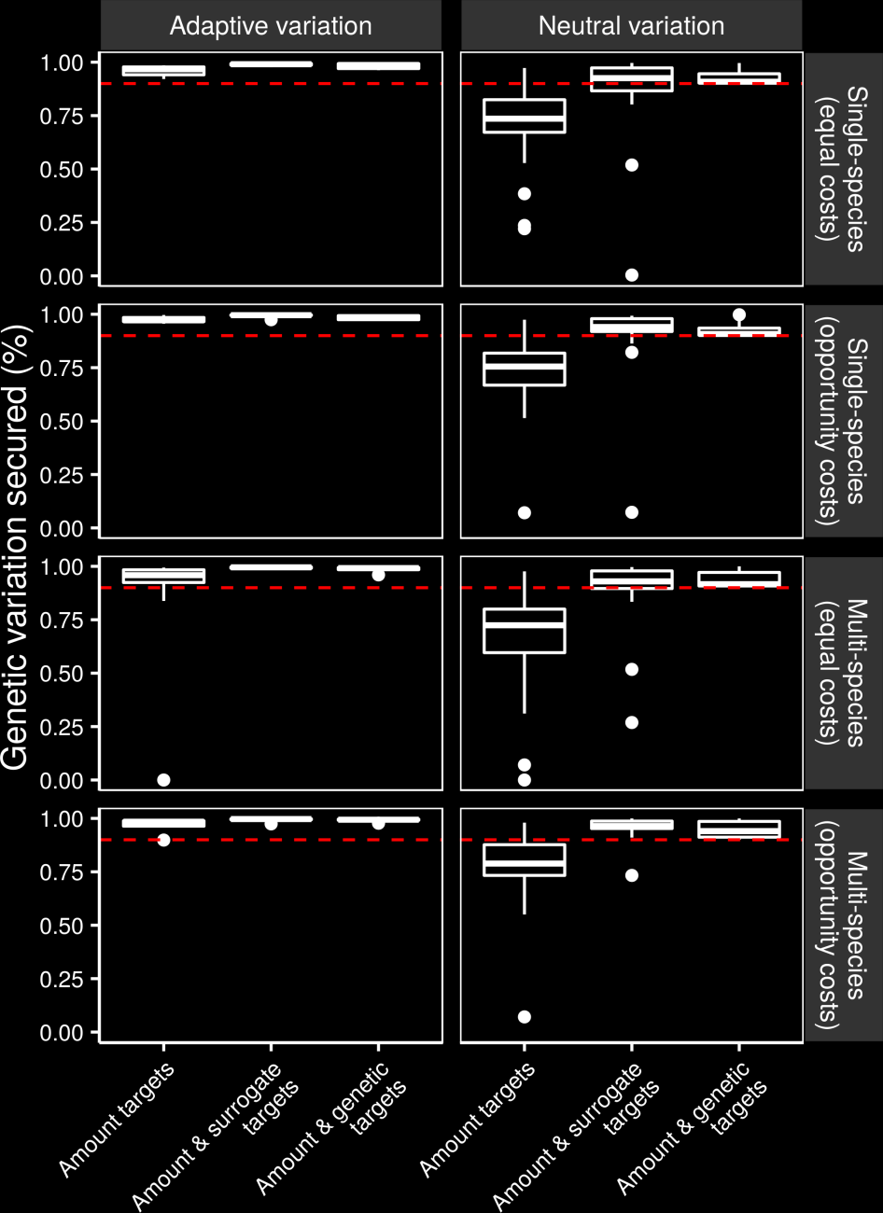
Can we make better decisions using surrogates?
Hanson et al. 2017 PNAS

Slide 56
Can we make better decisions using surrogates?
Hanson et al. 2017 PNAS

Slide 57
However, surrogates may not always work

Slide 58
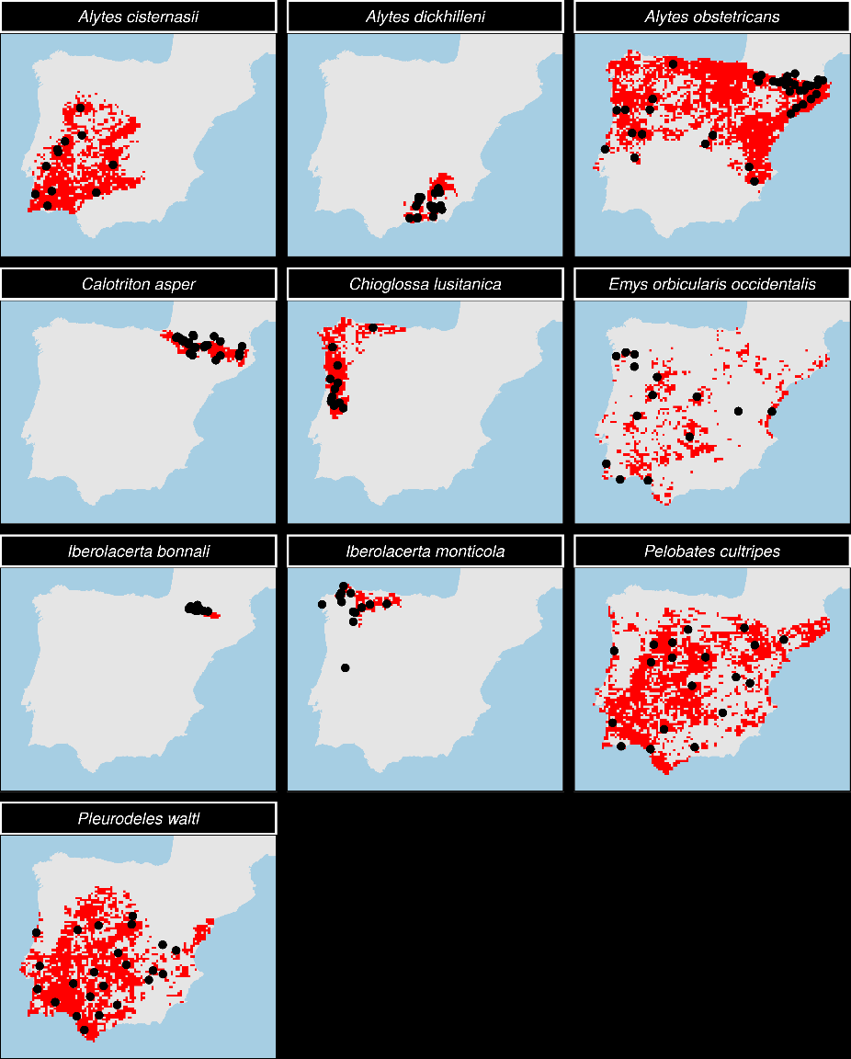
Evaluating surrogates of genetic diversity for conservation planning.
7 amphibian species
3 reptile species
Iberian Peninsula =
HARD MODE
Microsatellite markers
Hanson et al. 2020 Cons Biol

Slide 59
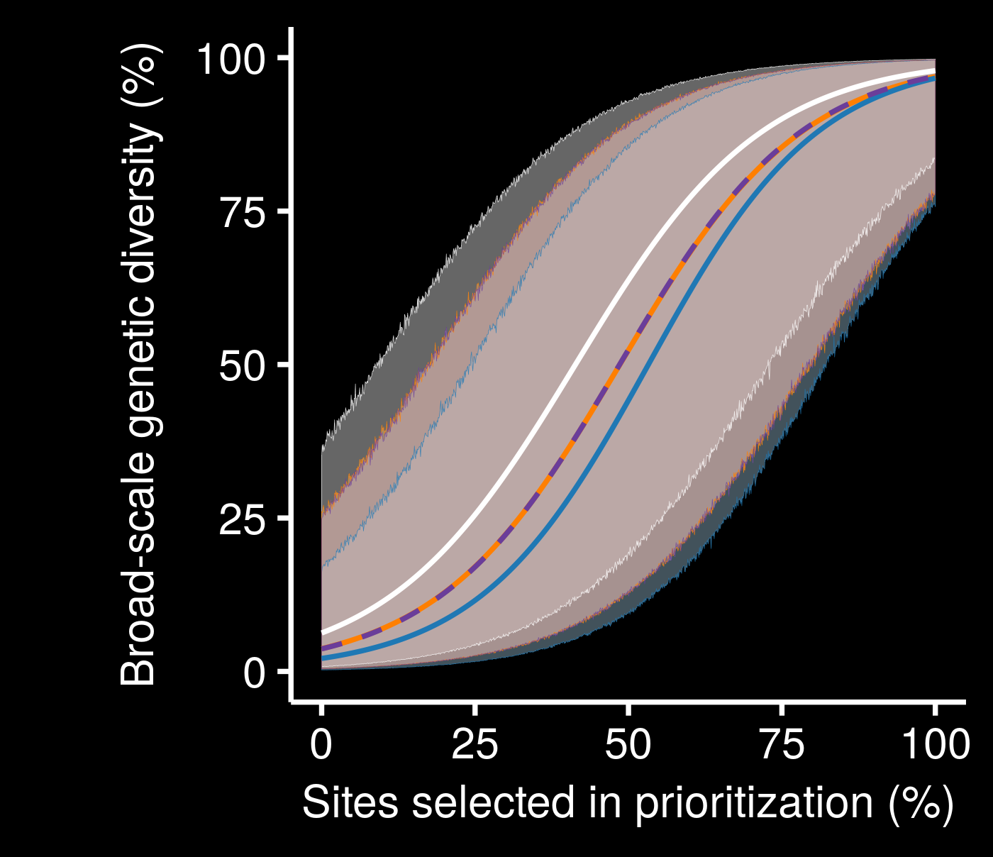
Surrogates may not perform much better than random
Not really a consistent relationship between different species
Very little performance improvement with low budget
genetic
geographic
random
resistance
Hanson et al. 2020 Cons Biol

Slide 60
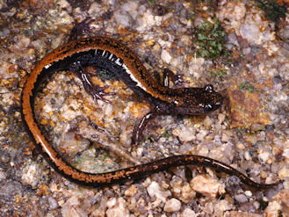
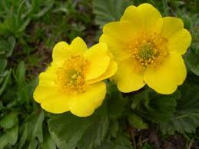
Surrogate performance
Performance might be greater in some environments, and less in others (more research needed…)
Performance may depend species’ on dispersal mechanisms
No guarantees!

Slide 61
Assuming environmental surrogates work, what could that mean?

Slide 62
Global conservation of species niches
9,670 bird, 5,070 mammal, 5,197 amphibian species
5 × 5 km maps delineating suitable habitat
Split each species’ distribution into 10 “environmental” partitions
Habitat targets set following standard approaches
Hanson et al. 2020 Nature

Slide 63
Italian Agile Frog
Hanson et al. 2020 Nature

Slide 64
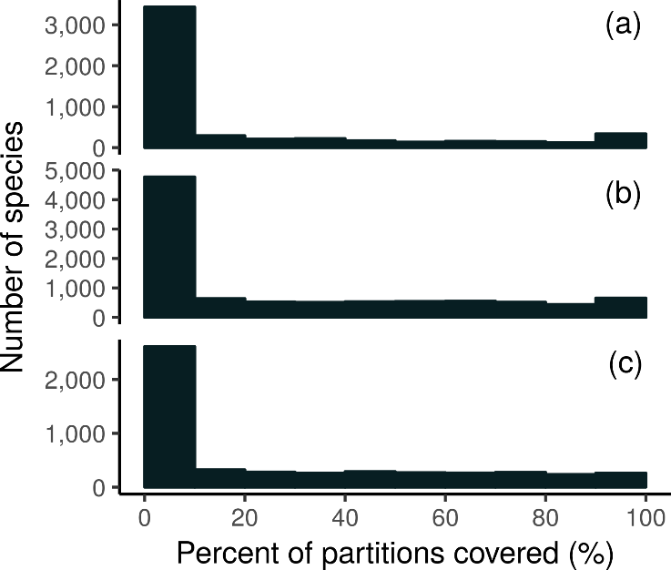
How good is the existing protected system?
18,688 (94%) species are not adequately represented in reserves
8,921 (45%) species do not have a single partition adequately represented
Of these 8,921 species, 2,266 species are globally imperilled
Amphibians
Birds
Mammals
Hanson et al. 2020 Nature

Slide 65
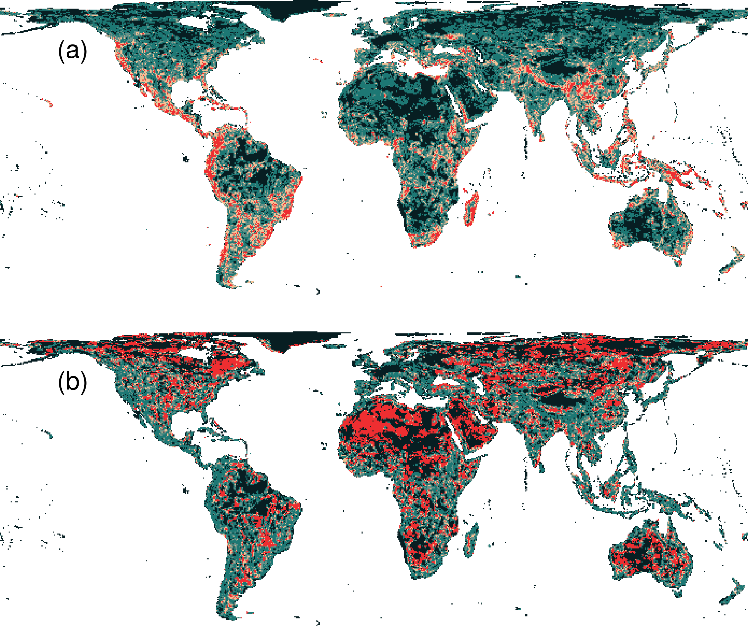
Prioritization for realized niches
35.9 % of the Earth’s land needed to complement existing protected areas
Biodiversity hotspots are critically important
Conservation efforts needed across the planet
Hanson et al. 2020 Nature

Slide 66
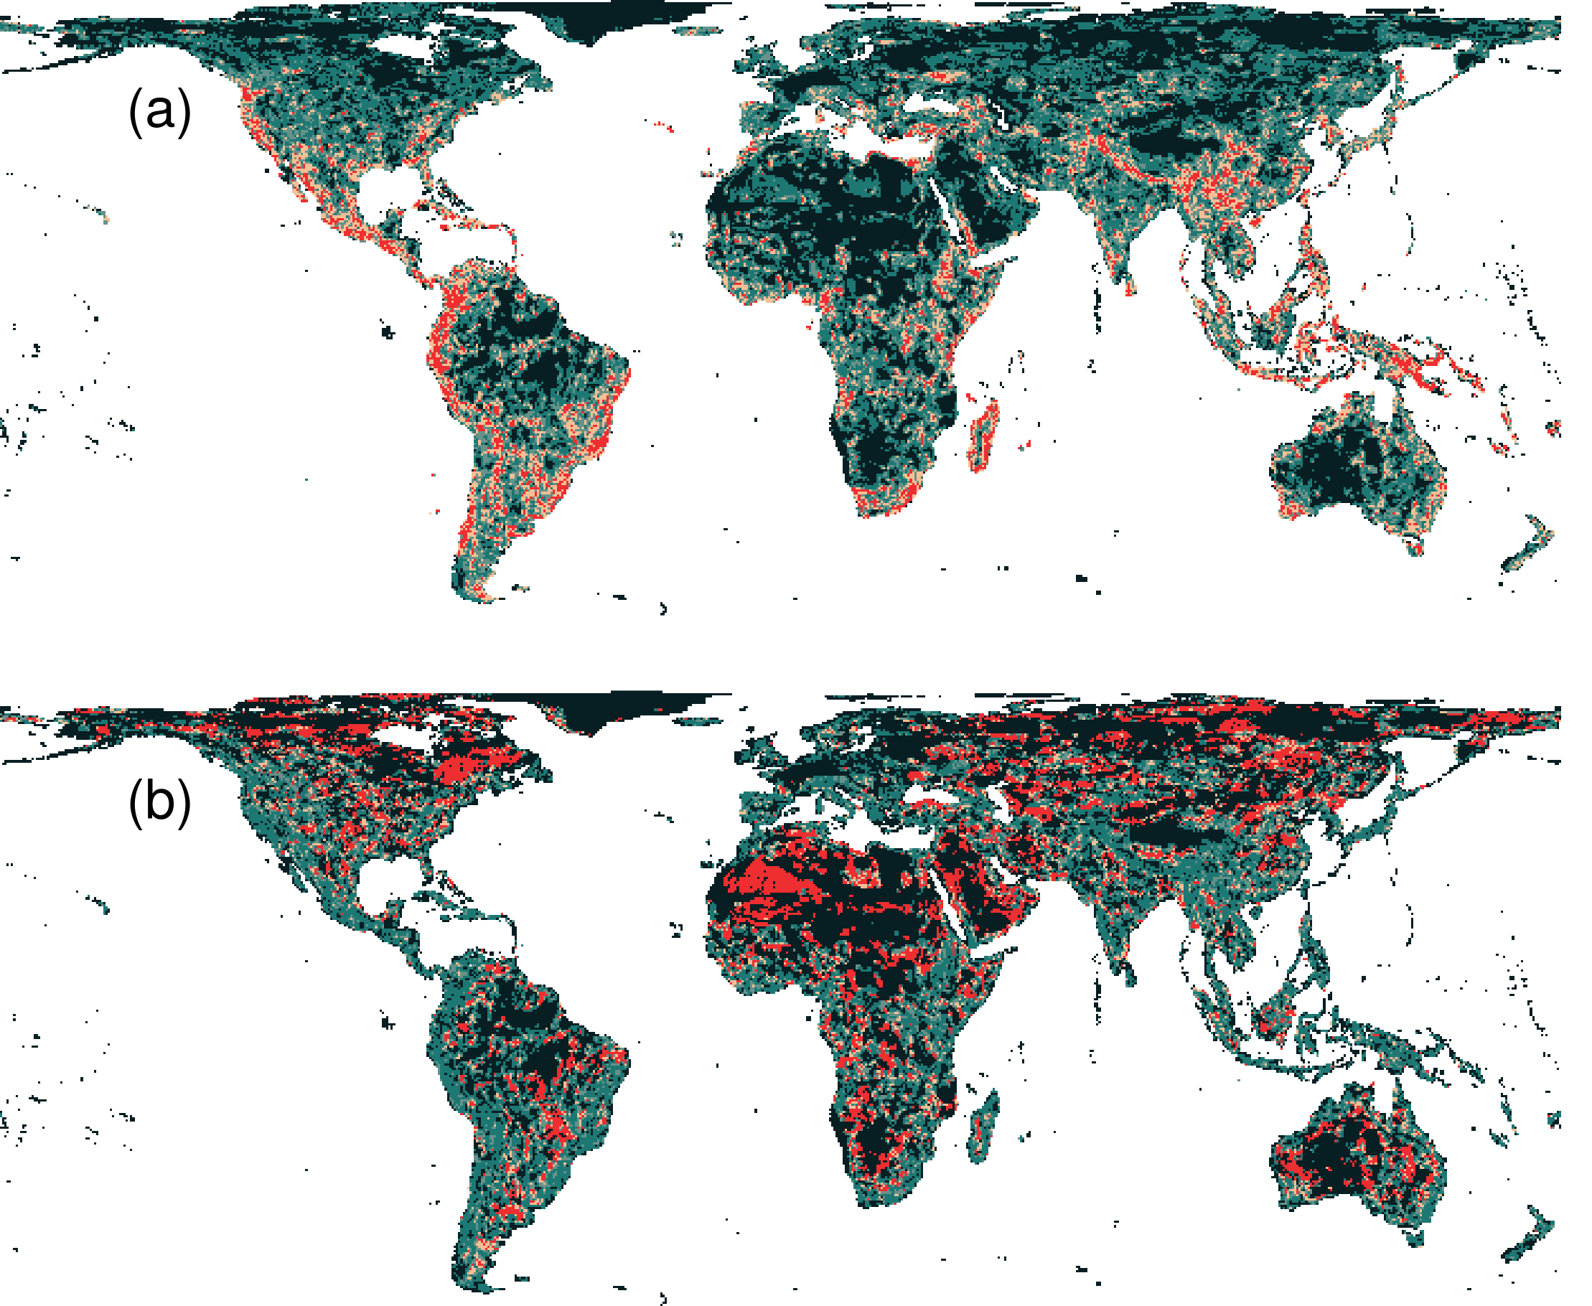
What if we ignore species niches?
Only 3.7% less of the Earth’s land than prioritization which considers niches
Fails to adequately represent 7,989 (40%) species
Hanson et al. 2020 Nature

Slide 67
How can we get a better conservation decision?
(1) Better algorithms
(2) Better data
(3) Better surrogates
(4) Other stuff too!

Slide 68



jeffrey.hanson@uqconnect.edu.au
github.com/jeffreyhanson
jeffrey-hanson.com

Slide 69
Appendix

